Slide 1
Pursuing State Clean Energy Policies/Resources in the Wake of FERC's MOPR Decision
Energy Policy Roundtable in the PJM Footprint
April 28, 2020
Joe Bowring
Independent Market Monitor for PJM

Slide 2
PJM Markets
Competitive wholesale power markets work.
The goal is power at lowest possible cost.
PJM capacity market needs to be improved.
Market power in the last base auction.
Markets are good for all unit types.
Markets are good for renewables.
Markets create incentives for creative responses.
Markets preferred to planning.
Market alternative to subsidies to address carbon
Carbon price

Slide 3
MOPR Order
Order defines boundary between federal and state jurisdiction for PJM wholesale power market.
MOPR is not about market power.
MOPR is about defining competitive markets.
Definition of competitive offers in the capacity market
Net CONE
Net ACR
MOPR Order versus Sustainable Market Rule (SMR)

Slide 4
MOPR Order
State subsidies are distinguishing element.
Significant exemptions for existing resource categories:
Renewables
Demand side
Self supply
Offer floors
Existing resources subject to MOPR
New resources subject to MOPR

Slide 5
Impacts of MOPR Order
Detailed analysis/modeling shows no impact on capacity prices in upcoming capacity auction
Existing nuclear units with subsidies are expected to clear
Existing renewable resources are exempt
Existing self supply resources are exempt
Existing demand resources are exempt
Estimates of price increase are incorrect:
Commissioner Glick’s estimate
Grid Strategies’ estimate

Slide 6
Long term impacts of MOPR Order
Will renewable supply be competitive?
Renewables contribution to capacity/reliability.
Will states implement carbon pricing?
Least cost approach to low carbon
Option: Markets with MOPR
Option: Markets with SMR
Option: Markets with carbon price
Option: Markets plus targeted RECs/subsidies
Option: FRR instead of markets

Slide 7
CONE offer floors
Default net CONE values are relatively low for combined cycle plants and high for coal and nuclear plants.
Default net CONE values for onshore and offshore wind, and for solar, are high enough that offers based on these values would be unlikely to clear in a capacity auction, based on the clearing prices in recent capacity auctions.
Unit specific values may vary significantly from these values.
Unit specific values for renewables lower than default.

Slide 8
ACR offer floors
Default net ACR values, excluding major maintenance, for all existing technologies are close to zero, with the exception of coal and diesel and single unit nuclear.
Based on the net ACR values and the clearing prices in recent capacity auctions, all existing technologies except single unit nuclear plants would be expected to clear if subject to a net ACR MOPR price floor.
Unit specific values may vary significantly from these values.

Slide 9
PJM and IMM Net CONE MOPR floor prices

Slide 10
PJM and IMM ACR MOPR floor prices

Slide 11
IMM Implied Nuclear Net ACR

Slide 12
FRR option
In order to create a new FRR service area, a utility must elect the FRR option consistent with the PJM Market Rules. The utility can be required to make the FRR election by the state in which the FRR exists.
Regardless of the existence of retail choice, the FRR entity must include all load in the FRR service area for all LSEs and must provide adequate capacity to meet that load.
LSEs are required to pay the FRR entity based on a state mandated compensation mechanism or based on the rest of RTO capacity price in the absence of such a mechanism.

Slide 13
FRR option
Generators in the FRR area are not required to participate.
The creation of an FRR is likely to increase payments for capacity by customers.
The increase in payments by customers would be larger with additional subsidies.
Market power is an issue in an FRR. Generation owners gain market power in an FRR.
The actual price for capacity and any actual subsidies would be the result of a negotiation between generation owners and the state.

Slide 14
FRR option
Pricing scenarios for ComEd FRR
Clearing price = 2021/2022 BRA clearing price
Clearing price = 2021/2022 BRA offer cap
Direct subsidies
Pricing scenarios for MD FRR
Clearing price = 2021/2022 BRA clearing price
Clearing price = 2021/2022 BRA offer cap

Slide 15
ComEd FRR Scenario Summary

Slide 16
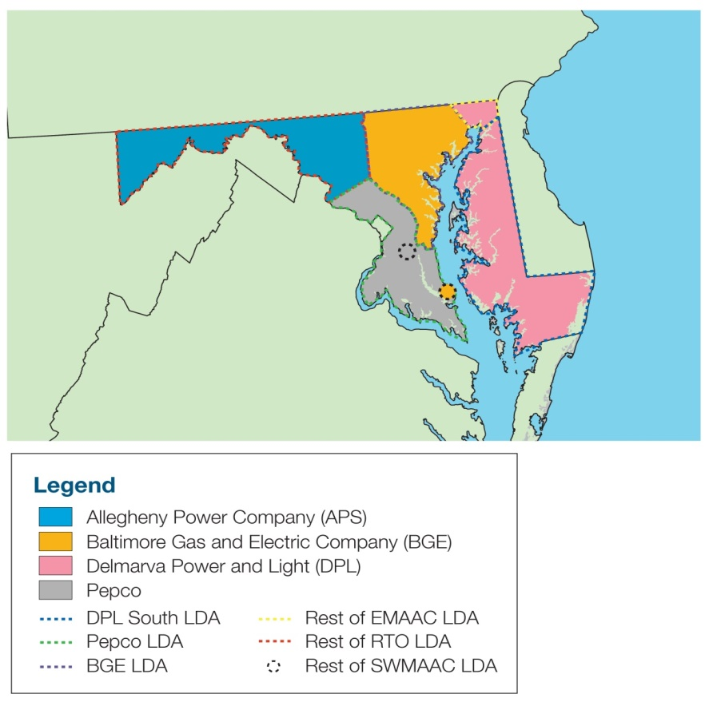
Maryland zones and modeled LDAs

Slide 17
MD FRR scenario summary

Slide 18
Monitoring Analytics, LLC
2621 Van Buren Avenue
Suite 160
Eagleville, PA
19403
(610) 271-8050
MA@monitoringanalytics.com
www.MonitoringAnalytics.com

